Slide 1
Fraud Detection in Financial Transactions
Source: Kaggle - Credit Card Fraud Detection Dataset
Name:K.Karunakar Roll No.: 2211CS010256

Slide 2
Introduction & Business Context
Dataset & Objectives
Methodology & Technologies
Data Processing & Feature Engineering
Visualization & Insights
Predictive Modeling & Performance
Key Findings
Conclusion
Table of Contents

Slide 3
Introduction & Business Context
Traditional rule-based fraud detection systems often fail to keep pace with increasingly sophisticated fraud patterns. This project addresses this challenge by implementing advanced machine learning techniques to analyze transaction patterns and proactively identify fraudulent activities.
Business Impact:
• Minimize financial losses from fraudulent transactions
• Enhance security for customers and financial institutions
• Reduce manual review efforts through automated detection
• Enable real-time fraud prevention

Slide 4
Dataset & Objectives
Dataset Description
Credit card transaction data from European cardholders (September 2013)
Total Transactions:260,674
Features:31 variables
Fraud Rate:0.18% (492 cases)
Feature Breakdown
• Time — Seconds elapsed from first transaction
• Amount — Transaction amount
• V1-V28 — PCA transformed features
• Class — Target (1=Fraud, 0=Legitimate)

Slide 5
Methodology & Technologies
Technology Stack
PySpark
Distributed data processing and ML training
Python Core programming language
Pandas Data manipulation and analysis
Matplotlib & Seaborn Data visualization
Jupyter Notebook Interactive development
Technology Stack
Phase 1: Data Preprocessing Load data • Handle imbalance • Feature scaling Phase 2: Model Development Logistic Regression • Random Forest • Hyperparameter tuning Phase 3: Evaluation AUC-ROC, Precision, Recall • Focus on fraud detection Phase 4: Insights Visualizations • Recommendations

Slide 6
Data Preprocessing & Feature Engineering
Class Imbalance Treatment: The dataset had only 0.17% fraudulent transactions. Used undersampling of the majority class in PySpark to balance data and help the model learn patterns from both classes effectively.
Feature Scaling: Applied StandardScaler (PySpark MLlib) to standardize Time and Amount features, ensuring equal contribution and preventing bias toward large-scale variables.
Data Partitioning: Split data into 80% training and 20% testing using Spark’s randomSplit(), maintaining representativeness and supporting distributed processing.
PySpark Role: Enabled distributed preprocessing, efficient data transformation, and a scalable pipeline suitable for large-scale fraud detection tasks.

Slide 7
Visualization & Insights
To analyze transaction behavior, fraud distribution, and key feature patterns.
Key Findings:
Class Distribution (Pie Chart): Only 0.18% fraud — severe imbalance; accuracy alone is misleading.
Amount (Boxplot): Fraudulent transactions have lower median amounts but occur across all ranges.
Time vs. Amount (Scatter): No strong time pattern — fraud occurs irregularly.
Feature Correlation (Heatmap): Weak correlations (PCA ensures independence).
Feature Distributions (Histograms): PCA features (V1–V3) show distinct fraud patterns.
Temporal Fraud (Line Plot): Fraud spread across 24 hrs, requiring real-time detection.

Slide 8
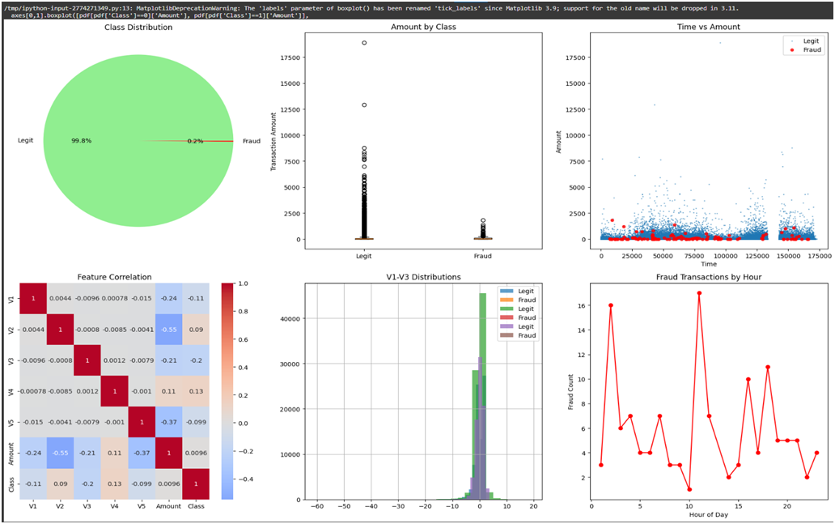

Slide 9
Predictive Modeling & Performance
Model Architecture
Classification Task:
Binary classification (Fraud vs. Legitimate)
Algorithms Implemented:
1.Logistic Regression — Baseline linear classifier
2.Random Forest Classifier — Ensemble decision tree model
Performance Metrics
Primary Metric: AUC-ROC
Robust to class imbalance
Secondary Metrics:
• Recall — Critical for capturing fraudulent transactions
• Precision — Balances false positive rate
• F1-Score — Harmonic mean of precision and recall
Winner: Random Forest Classifier
Demonstrates superior capability for fraud detection with exceptional AUC performance and ability to capture complex, non-linear fraud patterns.

Slide 10
Key Findings
1. Fraud Rarity: Only 0.18% of transactions are fraudulent, requiring specialized modeling approaches
2. Pattern Complexity: Fraud exhibits complex, multi-dimensional patterns not captured by simple rules
3. Feature Importance: PCA-derived features (V1-V28) are strong predictors of fraudulent activity
4. Model Effectiveness: Random Forest demonstrates exceptional performance in distinguishing fraud from legitimate transactions

Slide 11
Conclusion
This project successfully demonstrates the power of Big Data analytics and Machine Learning in combating financial fraud. The Random Forest model delivers exceptional performance, providing financial institutions with a robust, scalable solution for real-time fraud detection.
Future Research Directions
• Semi-supervised learning for utilizing unlabeled transactions
• Transfer learning from other fraud detection domains
• Explainable AI techniques for regulatory compliance
• Federated learning for cross-institutional fraud detection

Slide 12
THANK YOU

